Slide 1
Gaming Console Timeline
By Jalen Powell

Slide 2
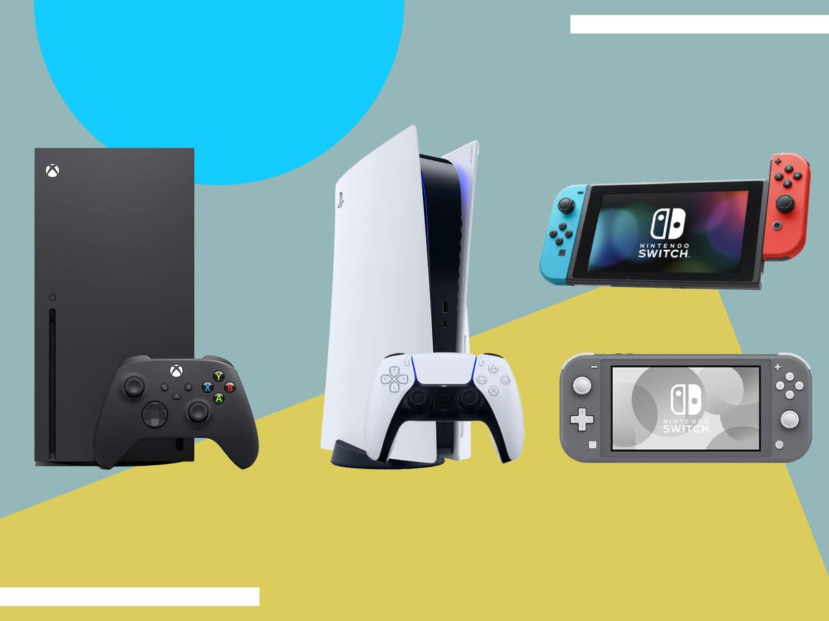
This is my progression through some of my gaming consoles.

Slide 4
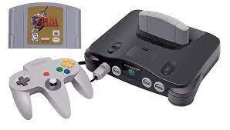
The Nintendo 64 everyone, one of the OG consoles in our early years.

Slide 6
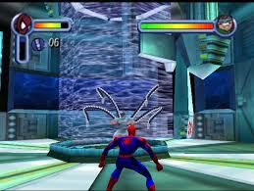
The final boss of this game is still so hard for me to beat. Its Doc Oct fused with Carnage.

Slide 8
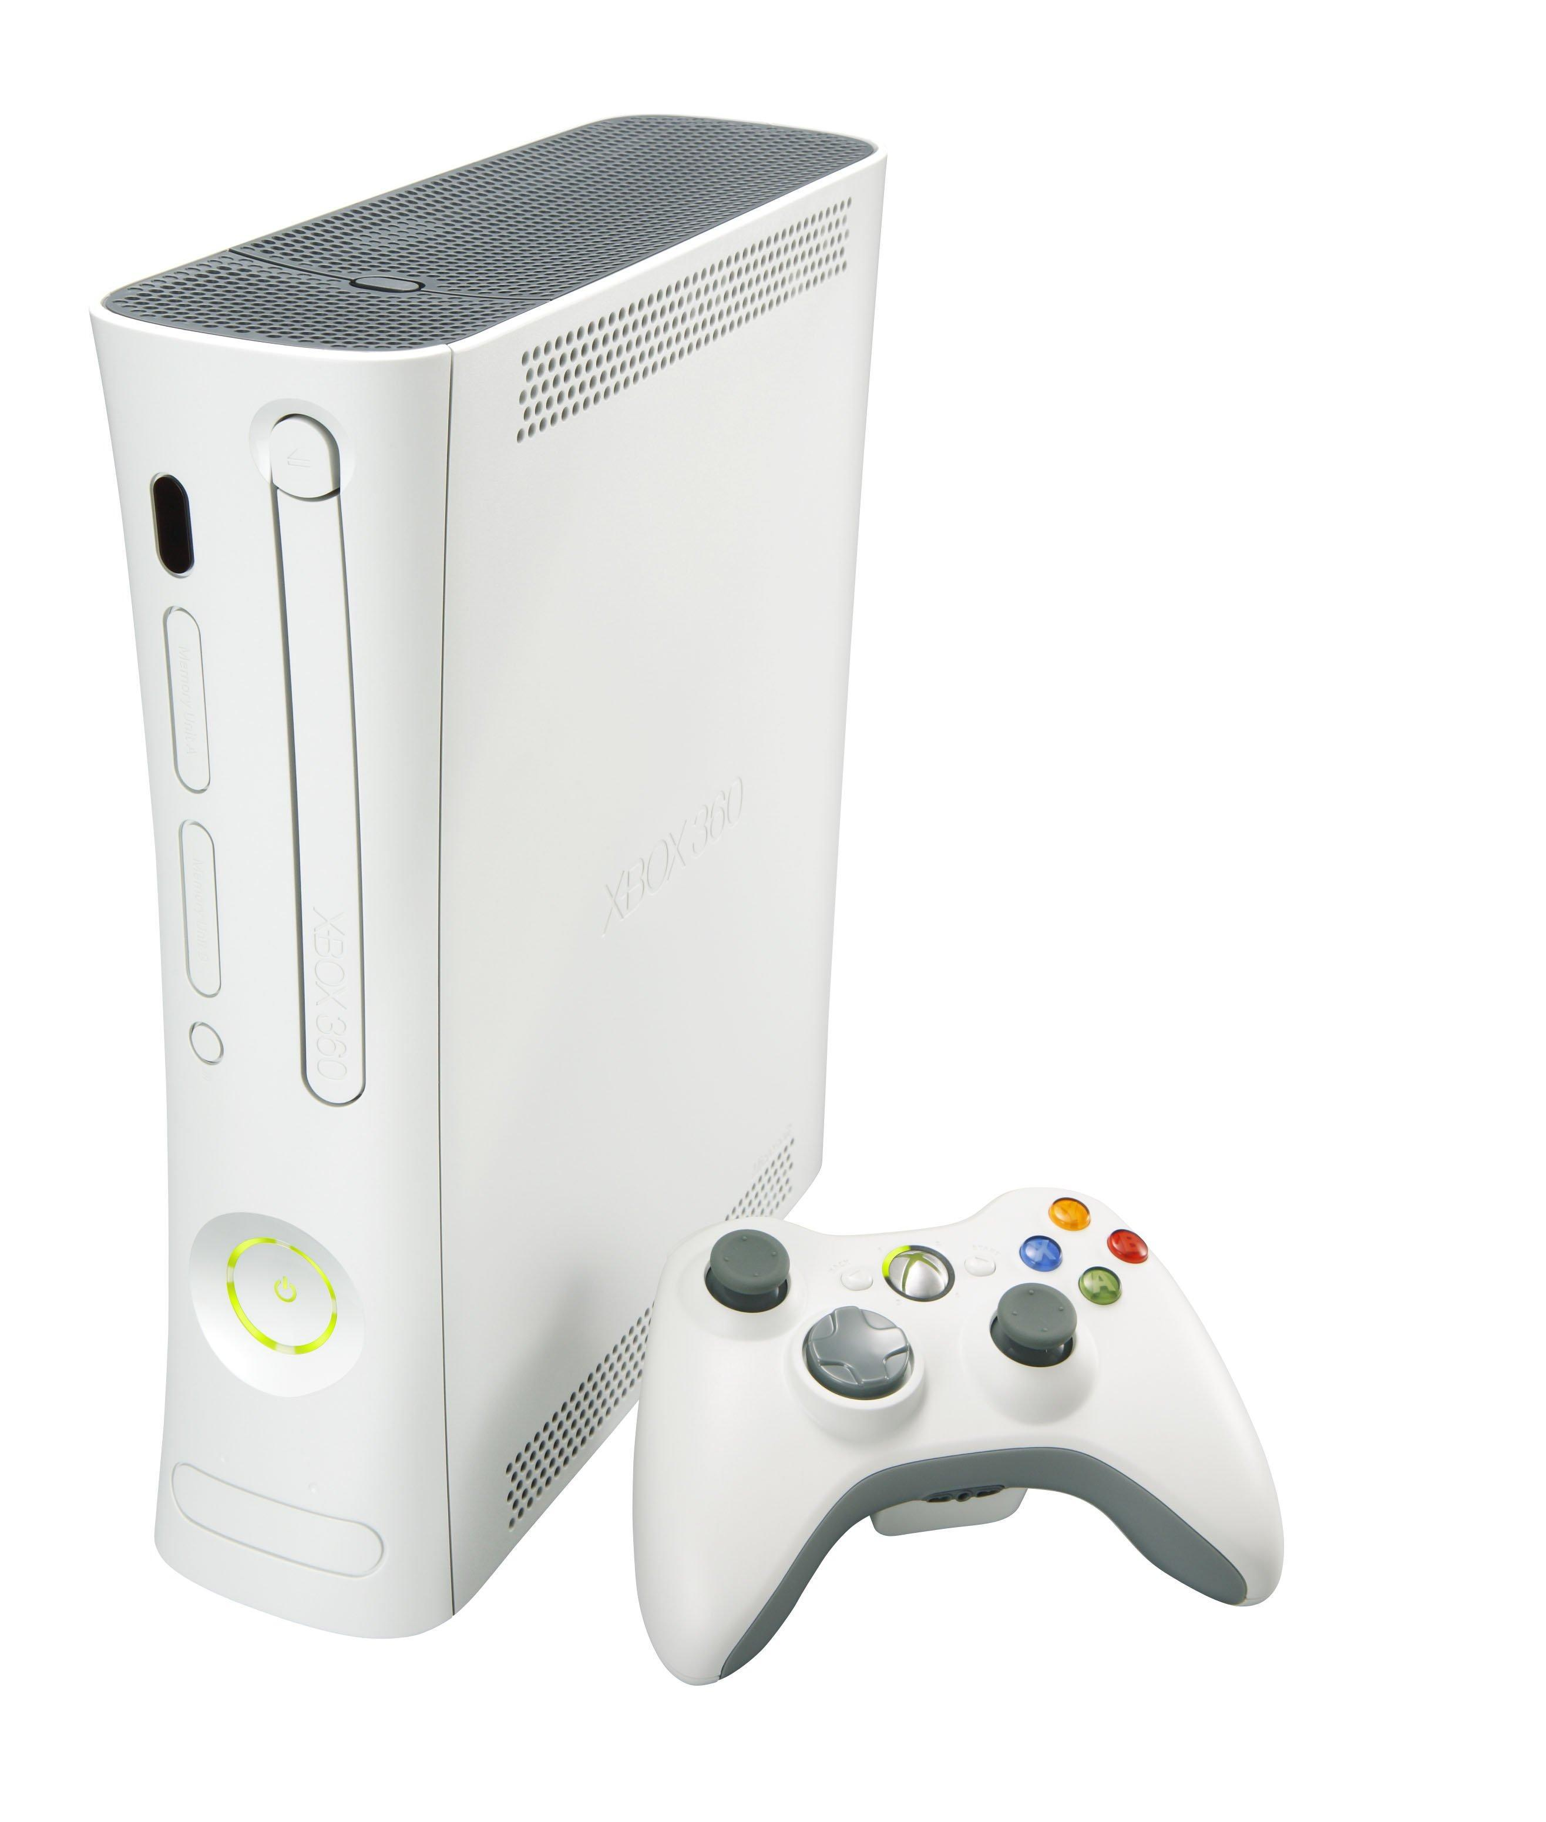
This is the only Xbox console I’d go back and play to this day. “Red Rings of Death”

Slide 10

Sonic Unleashed was such a top tier sonic game. From the Speed races to the jump puzzles in Beast form.

Slide 12
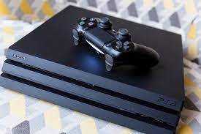
This console was my beginning to joining the dark side. What a time to be alive.

Slide 14

I played this on Xbox alittle but it was one of the only games I played on PS4.

Slide 16

This has been my journey through gaming consoles. Thanks for listening.

Slide 17
Reference Page
Myself
Google pictures

